Slide 1
Outer Join
Instructor: Kazi Amit Hasan

Slide 2



Outer Join
The result includes unmatched rows of one of the tables, or of both tables
Matching is based on the join condition
Use null values
Null signifies that the value is unknown or does not exist
Types of Outer Join:
Left Outer Join
Right Outer Join
Full Outer Join

Slide 3
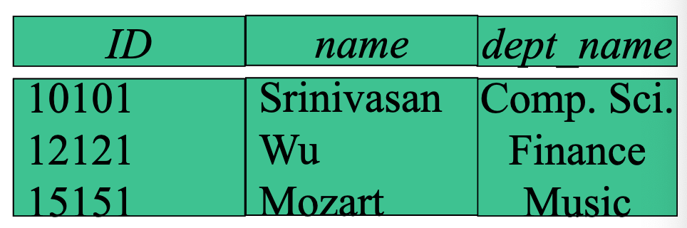
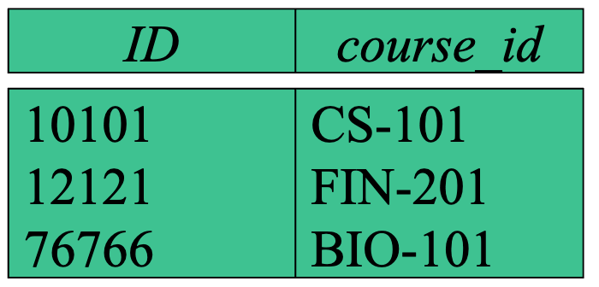

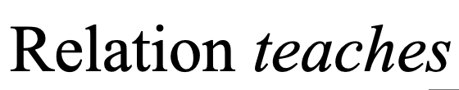

Slide 4
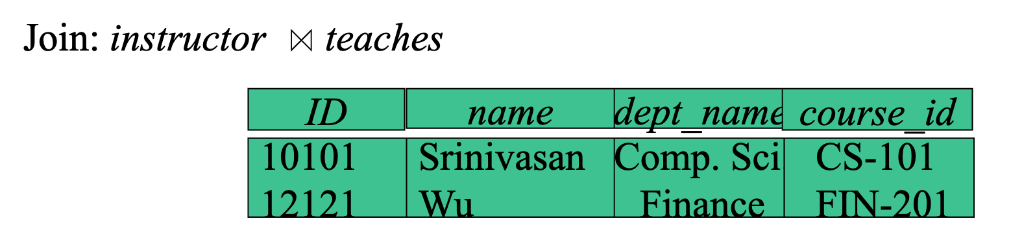
Perform natural join

Slide 5
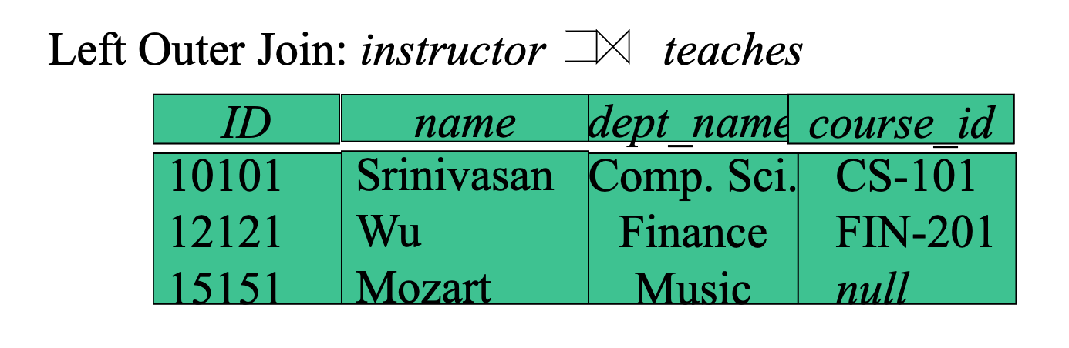

Slide 6
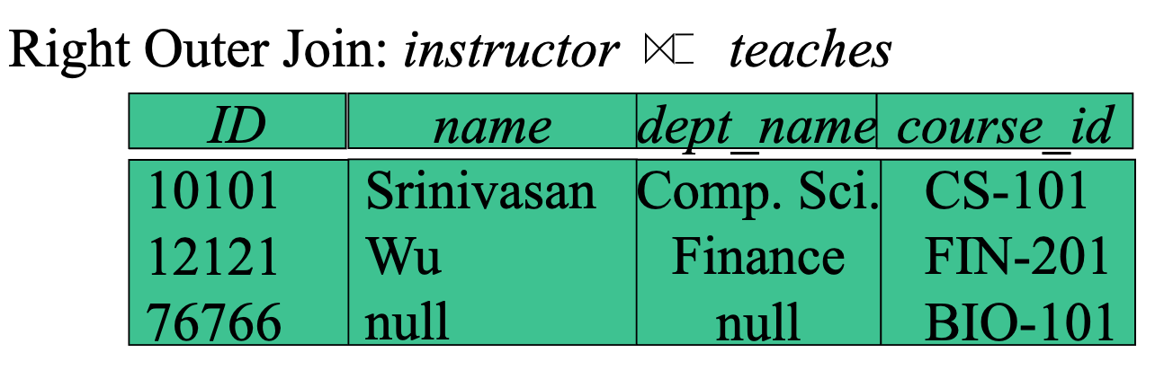

Slide 7
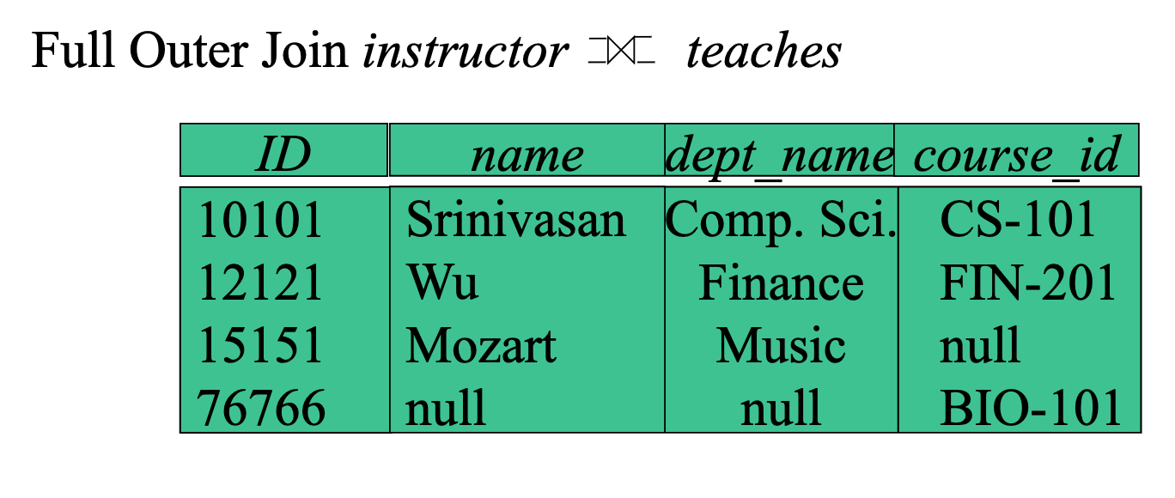

Slide 8
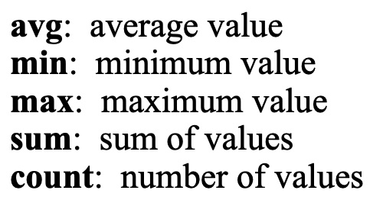
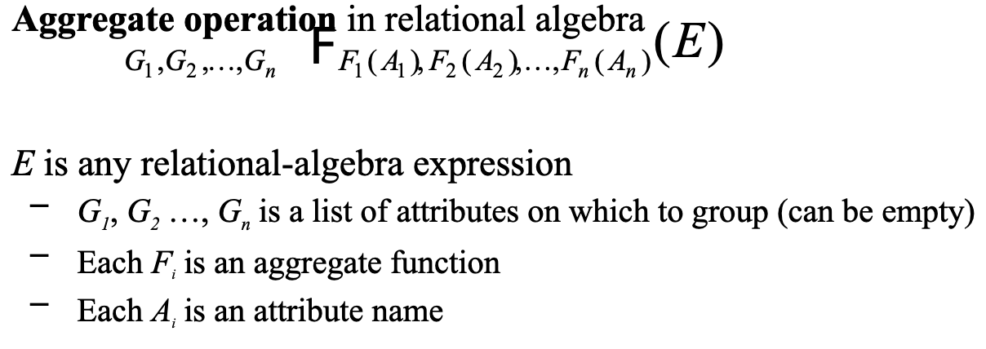
Aggregate Functions and Operations
Aggregation function takes a collection of values and returns a single value as a result

Slide 9
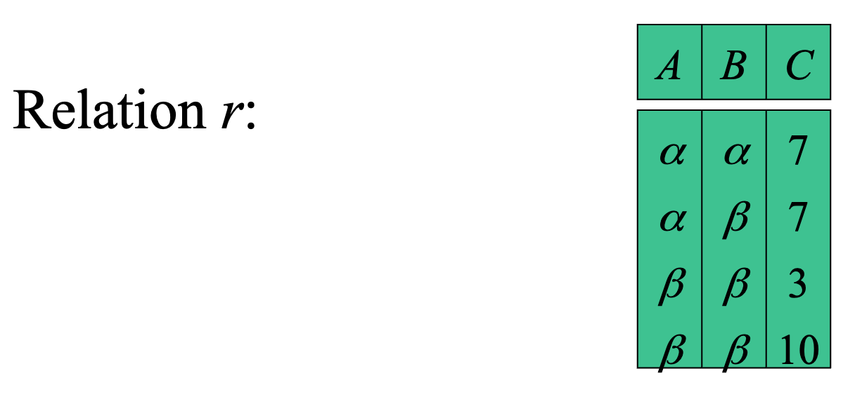
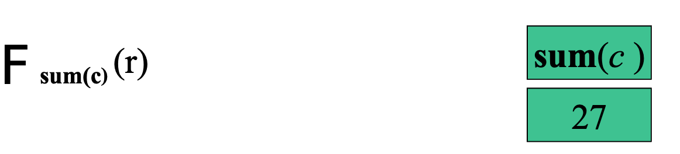
Aggregate Operation

Slide 10

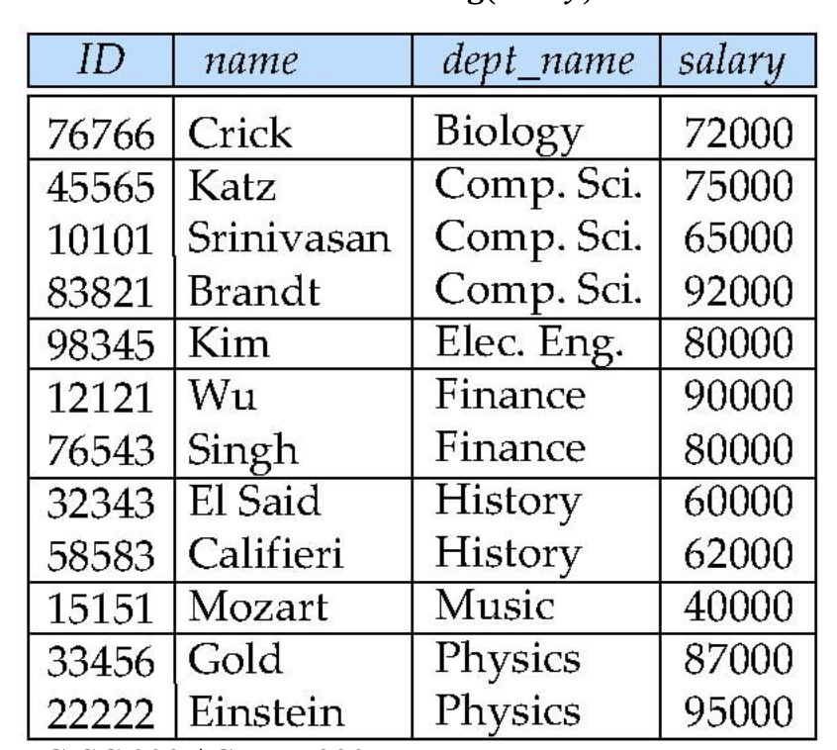
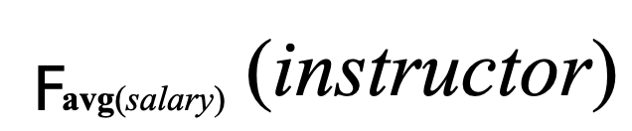
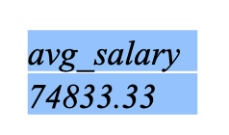

Slide 11
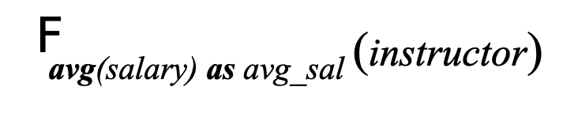
Aggregate Operation
Result of aggregation does not have a name
Can use rename operation to give it a name
For convenience, we permit renaming as part of aggregate operation

Slide 12
Recommended practice for final exam
Book: Database system concepts by Silberschatz (6th edition)
6.1, 6.2, 6.8, 6.10, 6.11, 6.12, 6.14, 6.15,

